Slide 1
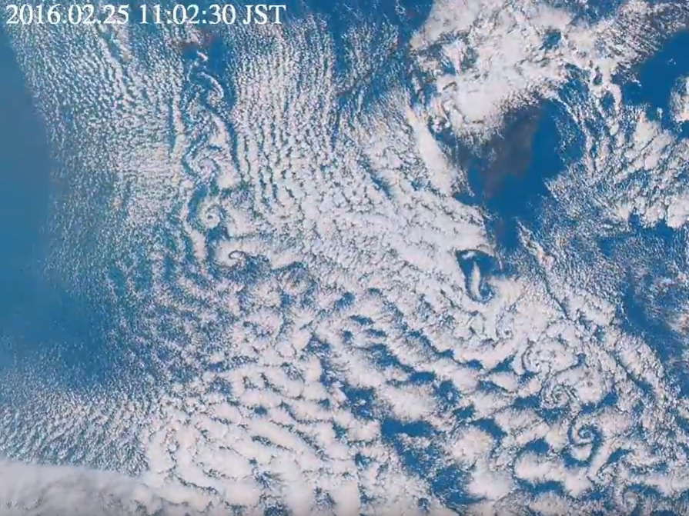
Karman vortex street
https://www.youtube.com/watch?v=A3O268FcaYA

Slide 2
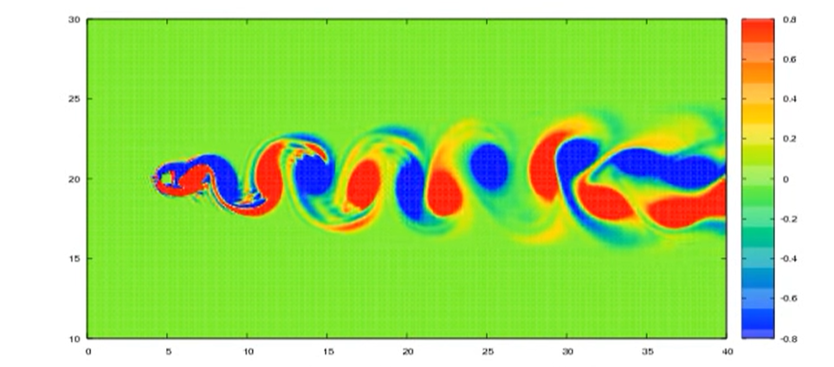
Karman vortex street
Behavior of Karman vortex street is dependent on the Reynolds number

Slide 3
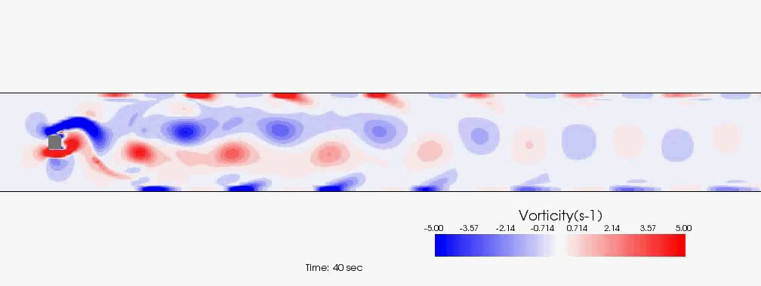
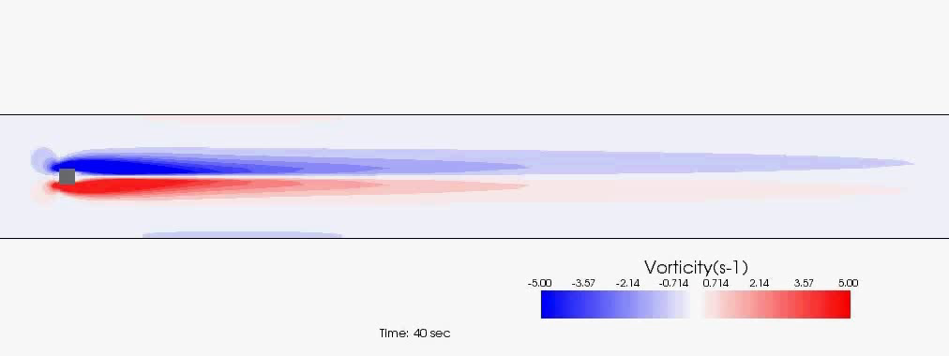
Effect of numerical diffusion
－ CIP Method － 1st order upwind scheme
Notes:
But, the model performance is highly dependent to selection of the computational scheme. Here is other example of the unsteady flow feature, Karman vortex street behind a rectangular obstacle. Upper one is a result using an accurate numerical method for advection term of the momentum equation (nonlinear tem of the shallow flow model). Lower is the result of the 1st order upwind scheme, which is a low accuracy, but stable method because of the large numerical diffusion. You can see that the lower model cant reproduce the karman vortex street. You need to pay attention to this fact. But, sometimes high accuracy method may cause really unstable flow pattern, so the computation just explode for some reason. In that case, you can choose stable method instead of the high accuracy method to seek the reason for computational unstable. Sometimes, initial and boundary conditions are not set correctly, resulting in the computational unstable. For that reason, low accuracy method can be acceptable.

